Slide 1
BSA REAL
TALK

Slide 2
Can You Hear Me?
A Meditation on the Worth of Black Bodies and Black Voices at PWI’s and Beyond

Slide 3
https://www.youtube.com/watch?v=M33D12TJRdE

Slide 4
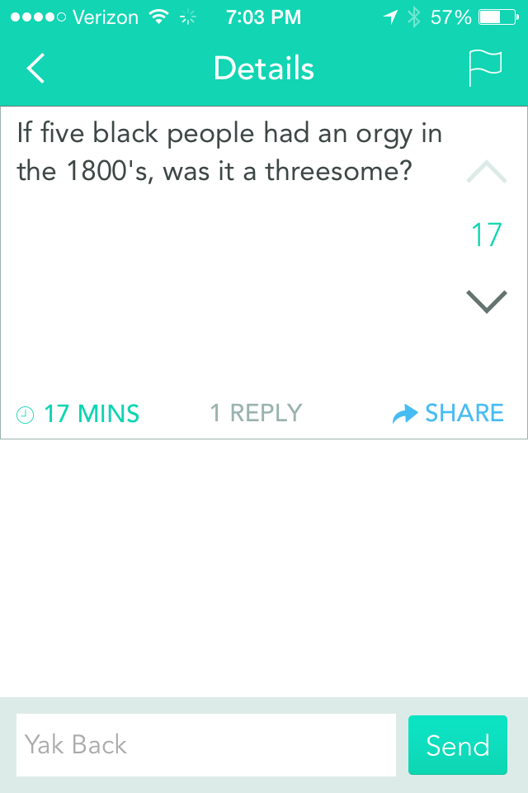

Slide 5
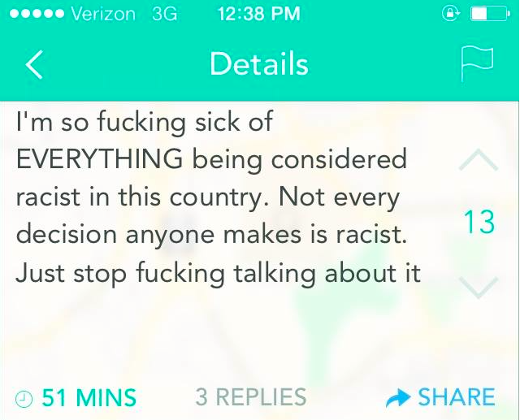

Slide 7
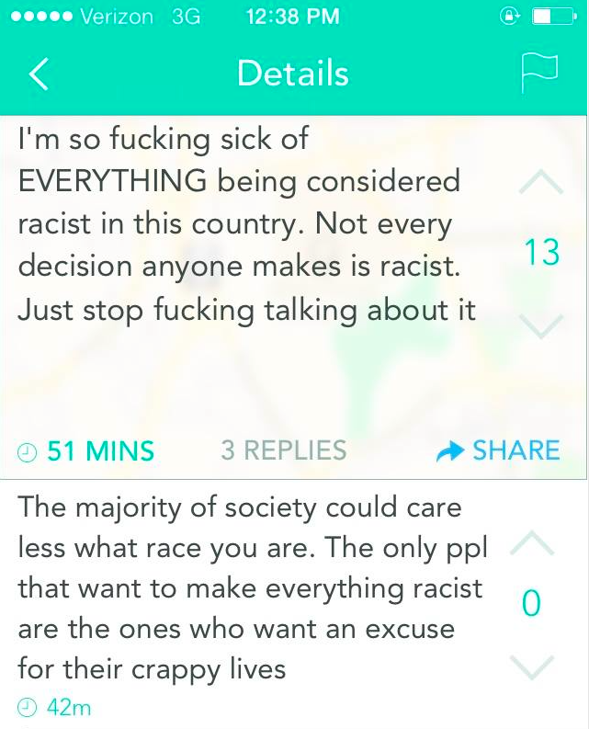

Slide 8
Excerpts from White frat party is latest wound to students of color at Wake Forest
“African-American residential advisors were asked by their white advisees whether they were dressed “black enough” and whether could borrow their clothes for the party.”
“I know how to dress for this; I’m sooooo ghetto.”
“Why do we have certain looks that have to be associated with us as African Americans?”
“As I know many of you are aware, our students have been grappling with complex issues regarding difference, and particularly race, in recent days. Much divisive commentary has appeared on social media, and you may have noticed chalked messages and flyers on Manchester Plaza. Some students are deeply troubled by these events, and may even feel unsafe.”
‘The only people who cause racism to happen are the people who complain about racism,’

Slide 9
Excerpts from White frat party is latest wound to students of color at Wake Forest
“There were comments about lynchings and ‘Get your crosses and sheets.’ It sort of makes them feel at the very least unwelcomed and at the most unsafe.”
Leduc said he has had interactions with Wake Forest police that made him feel unwelcome, including being followed at night and asked if he belonged on campus. He said staff of color experience the same thing, citing an incident in which he said campus police asked a staff member for her ID while she was attempting to deliver supplies to an on-campus performance by hip-hop DJ 9th Wonder. Leduc added that the police didn’t seem satisfied when the staff member tried to show them her campus log-in information on a mobile device and then her Facebook page to prove that she was a staff member.
hostility surfaced dramatically in January when campus police shut down a party hosted by Kappa Alpha Psi, a black fraternity, that was held on campus.
“They called in backup because they thought a riot was going to break out,” said student Kristen McCain in a short documentary posted on YouTube. “There was a group of people waiting outside to get in. I had witnessed one kid get arrested for saying the ‘F’ word, and they claimed that he was getting aggressive.”

Slide 10
Excerpts from White frat party is latest wound to students of color at Wake Forest
“Developmental Associates, the firm that conducted the investigation, reported to the university in August that none of the allegations ‘rose to the level of actual bias.’”
Notes:
Even though parties are part of the social atmostphere of the university, parties like these require institutional response. And the institution’s understandings of race are revealed in how they respond to situateions as these.

Slide 11
Yet it’s interesting because while they want to “be” “black” for a night at these parties, where are they when this happens?....

Slide 12
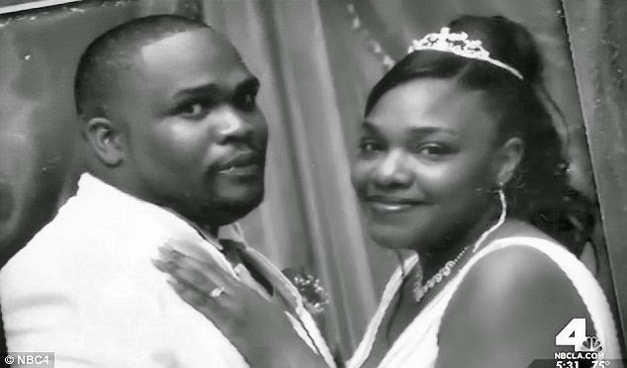
Dante Parker
Dante Parker, Victorville, California / August 12: A Victorville resident told police that a robbery suspect had fled on a bicycle. The police detained Dante Parker, a 36-year-old pressman at the Daily Press newspaper, apparently because they found him nearby on a bike. Though Parker had no criminal record (other than a DUI), a scuffle ensued and Parker was tased repeatedly when he resisted arrest, He began breathing heavily than was taken to a hospital where he later died.

Slide 13
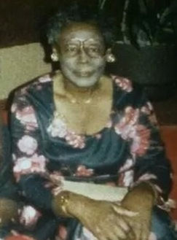
Pearlie golden
Oficer Stephen Stem, responding to a 911 call Tuesday night, fired at least three rounds at 93-year-old Pearlie Golden after she had fired two shots into the ground. Golden was hit at least twice and died at the hospital.

Slide 14
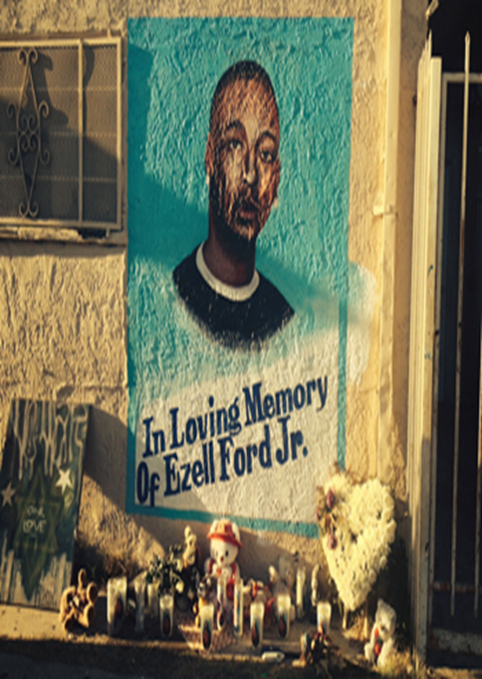
Ezell ford
When police conducted an "investigative stop" of 25-year-old Ezell Ford on a Los Angeles sidewalk, a woman who identified herself as Ford's mother said he was lying on the ground, complying with the officers' orders, when he was shot in the back.

Slide 15
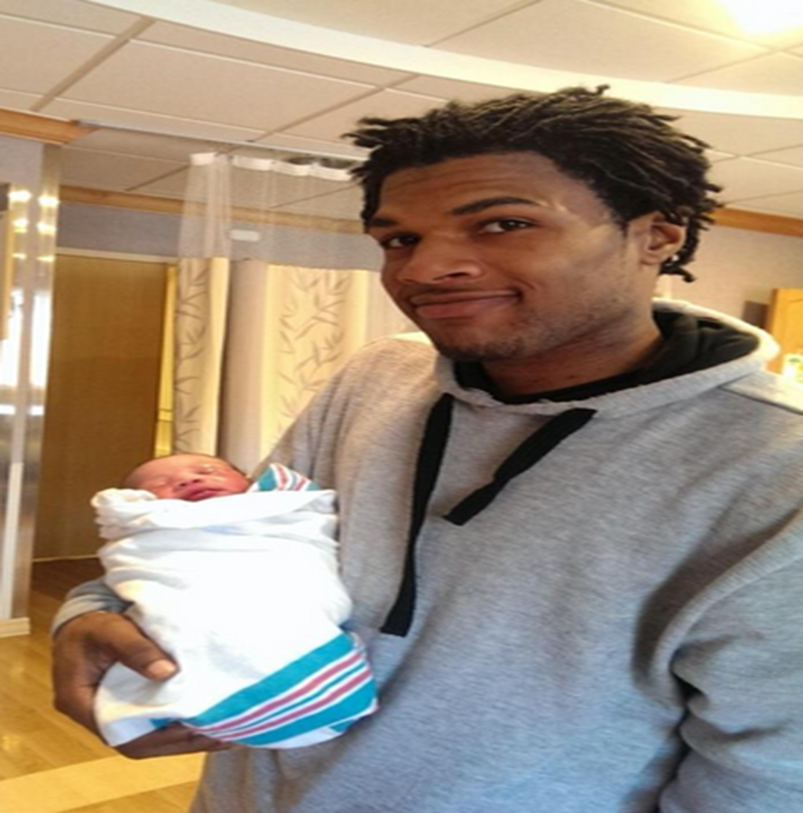
John crawford
Two police officers responded to a 911 call about a man waving a gun at customers inside a Walmart store. According the Beavercreek police department, 22-year-old John Crawford disregarded officers' orders to disarm before being fatally shot in the chest. Crawford's gun turned out to be a .177 calibre BB rifle that he'd picked up from a store shelf. "Why did John Crawford, a Walmart customer, get shot and killed carrying a BB gun in a store that sells BB guns?" asked Michael Wright

Slide 16
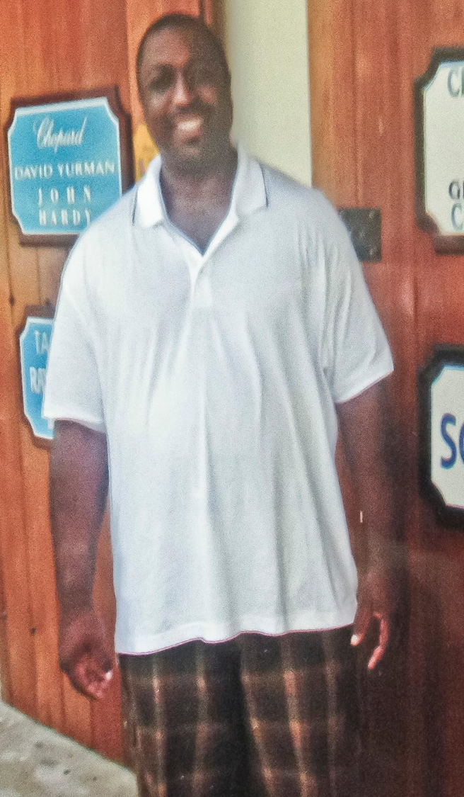
Eric garner
Eric Garner, a 43-year-old asthmatic father of six, was confronted by New York City police officers for allegedly selling untaxed cigarettes. When he resisted being cuffed, an officer appeared to put him in a chokehold—a tactic banned by the department since 1993. A video of the arrest, first shows Garner gasping, “I can’t breathe” before he died.

Slide 17
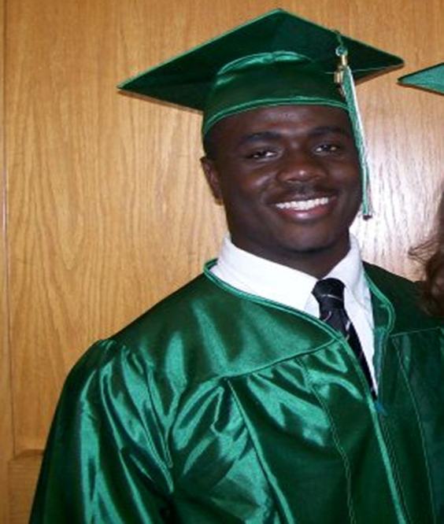
Jonathan Ferrell
Jonathan Ferrell had been in a traffic accident and was knocking on a homeowner's door for help. He was unarmed. An attorney later described a video of the incident, which reportedly showed that when police officers approached Jonathan, he was holding his hands out in a non-threatening manner. The police officers never identified themselves. One of them fired 12 times, and 10 of those bullets hit him. Even as Jonathan lay on the ground, bleeding and dying from 10 gunshot wounds, the officers handcuffed him. Jonathan's dead body remained handcuffed all the way to the medical examiner's office.

Slide 18
One of 7 black women raped by police officer Daniel holtzclaw
Oklahoma City police officer Daniel Ken Holtzclaw was released from jail Friday as he faces charges for allegedly sexually assaulting 7 different African American women while he was on duty. Among the claims against him are forcible rape, burglary, and felonious stalking.
The judge who initially set his bond at $5 million said he researched his target victims and tracked them down before assaulting them, according to Michigan Live.

Slide 19
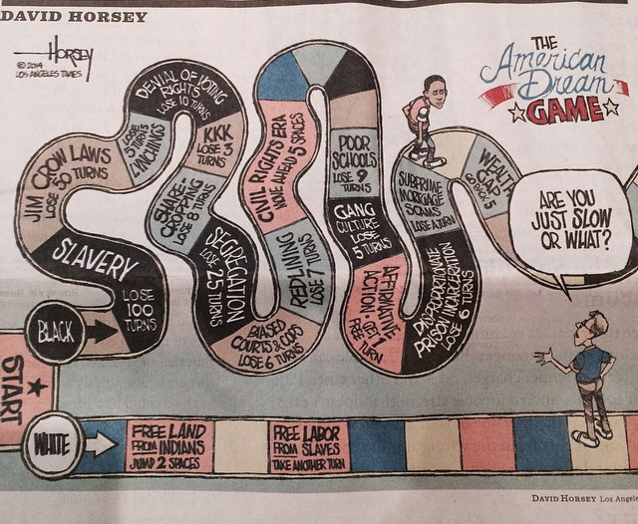
http://youtu.be/3-KBFuobhDk?t=2m

